Slide 1
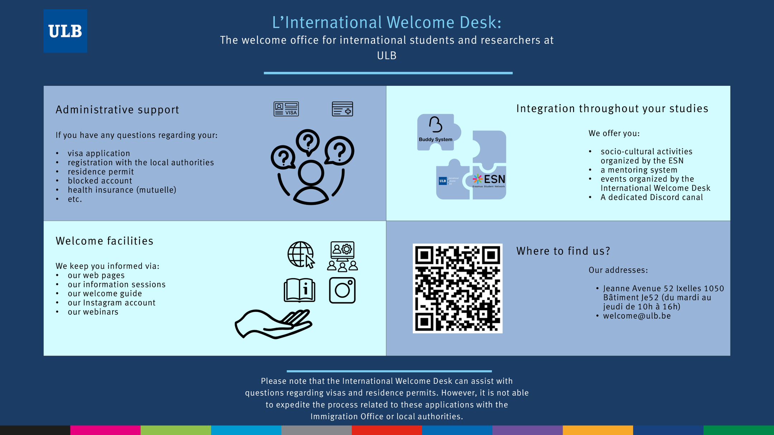

Slide 2

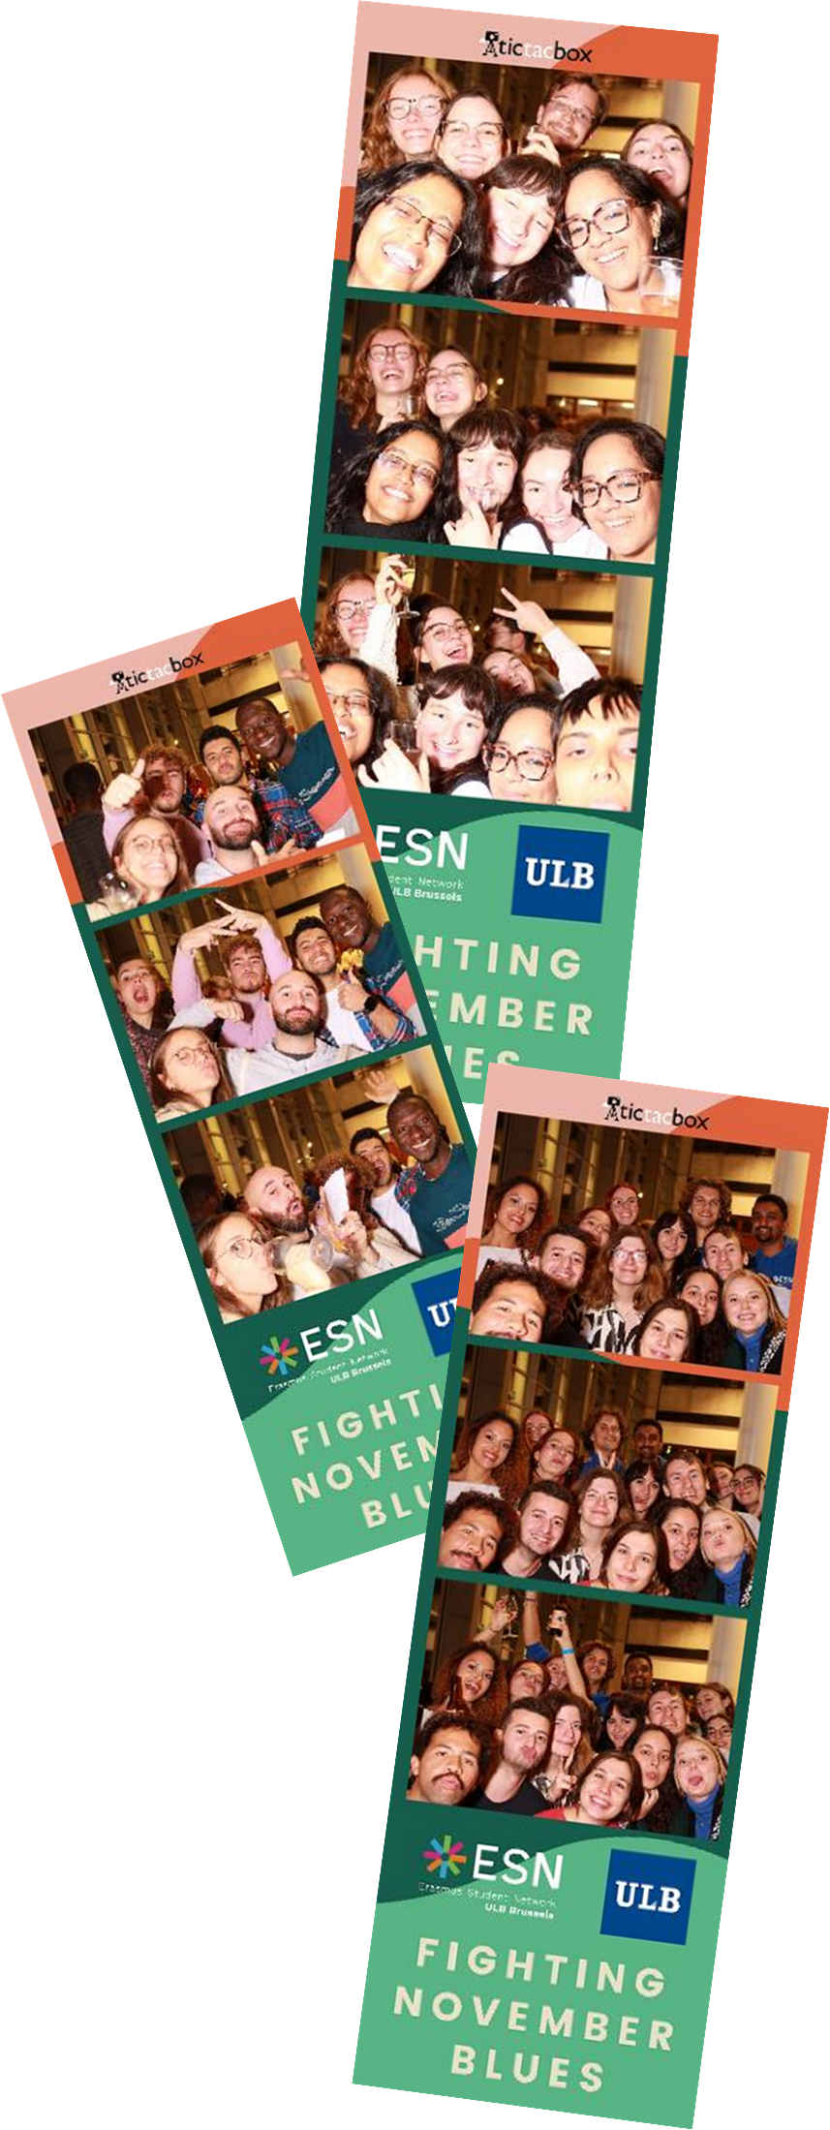
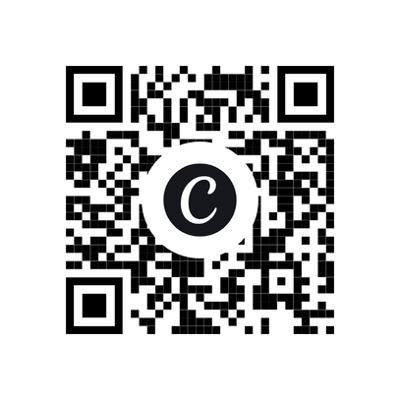


Integration at ULB
ULB events (Fighting November Blues, Cocktail des ambassadeurs, etc.)
Discord ULB - International
Application on which students can chat with
other international students in order to
create strong links before the start of the
academic year and to exchange throughout
the year.
Mutuelle registration (health insurances)
Partenamut will be present in our office (avenue jeanne 52) :
On Wednesdays from 10 a.m. to 1 p.m. until Wednesday October 7.

